Slide 1
social spark

Slide 2
what is social spark ?

Slide 3


Slide 4
its a platform for everyone to connect with their friends.

Slide 5
to build this platform we are using stable technologies like: HTML, CSS, JavaScript (front-end) PHP, MySQL (back-end)

Slide 6
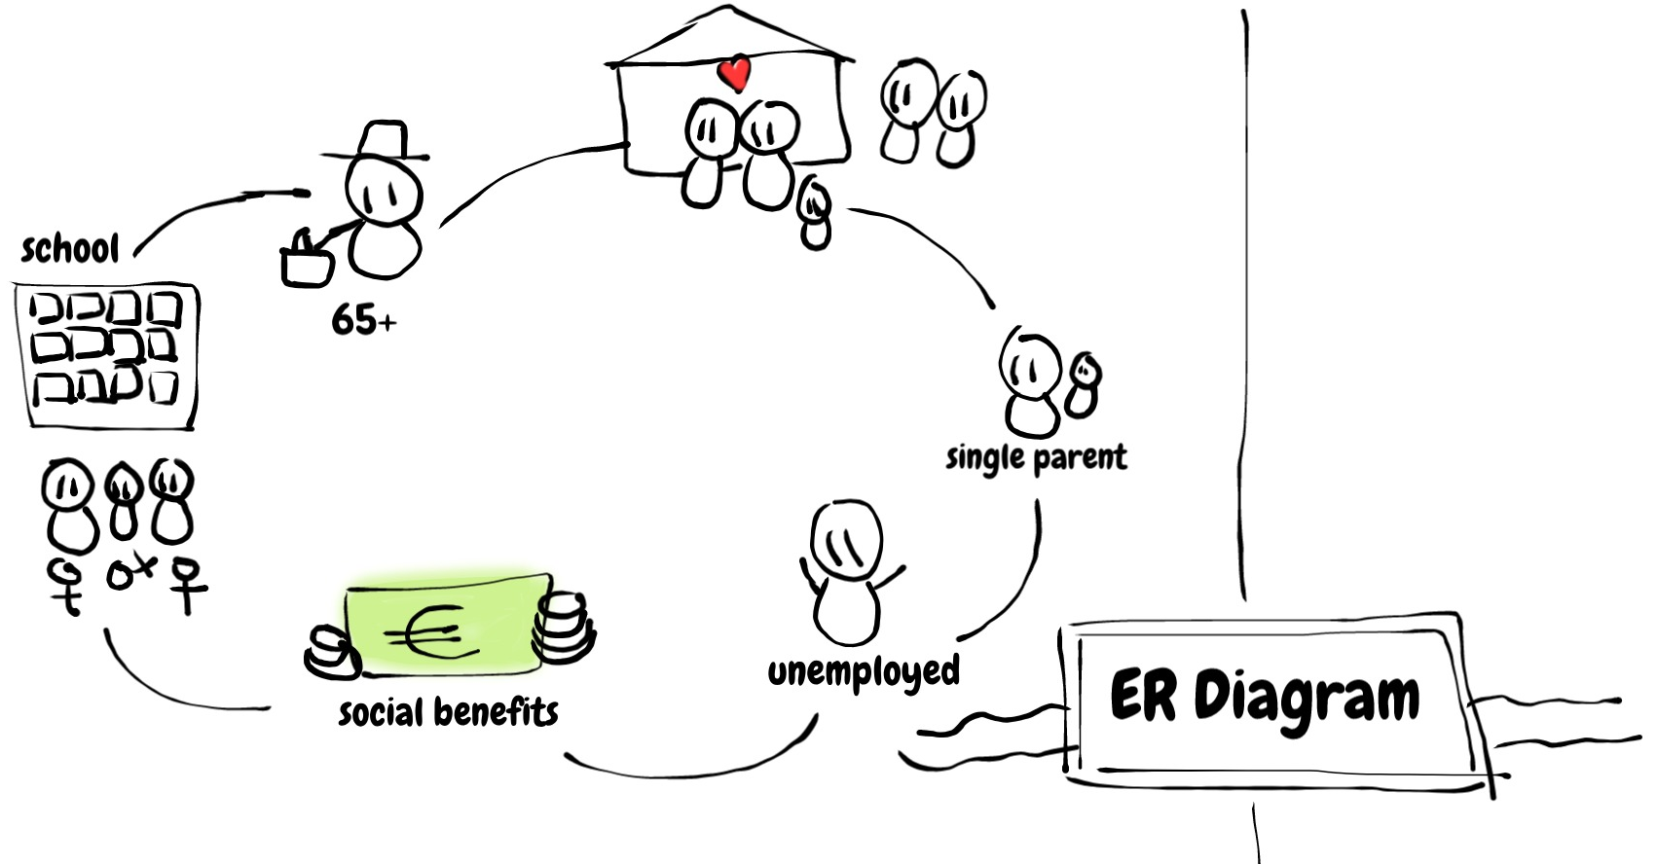

Slide 7
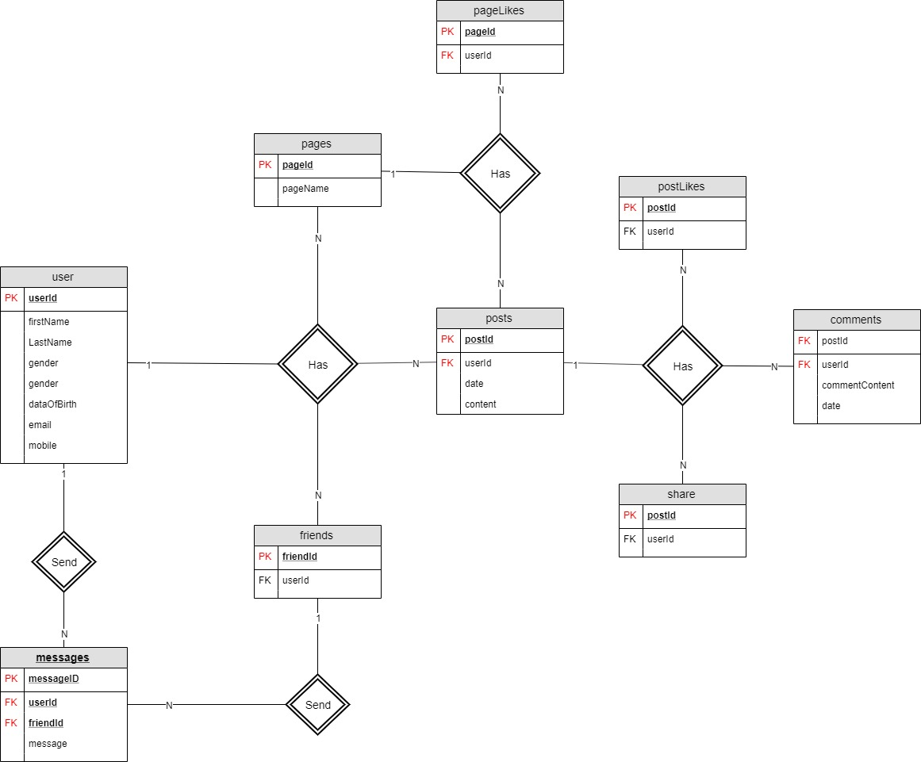

Slide 8
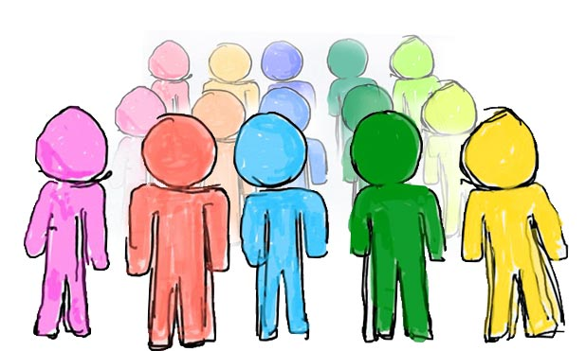
user

Slide 9
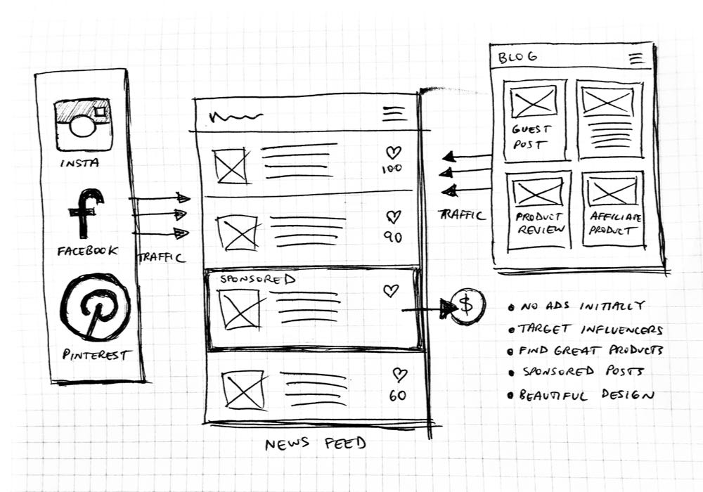
user
post

Slide 10
so first, lets talk about USERS

Slide 12
POSTS

Slide 13
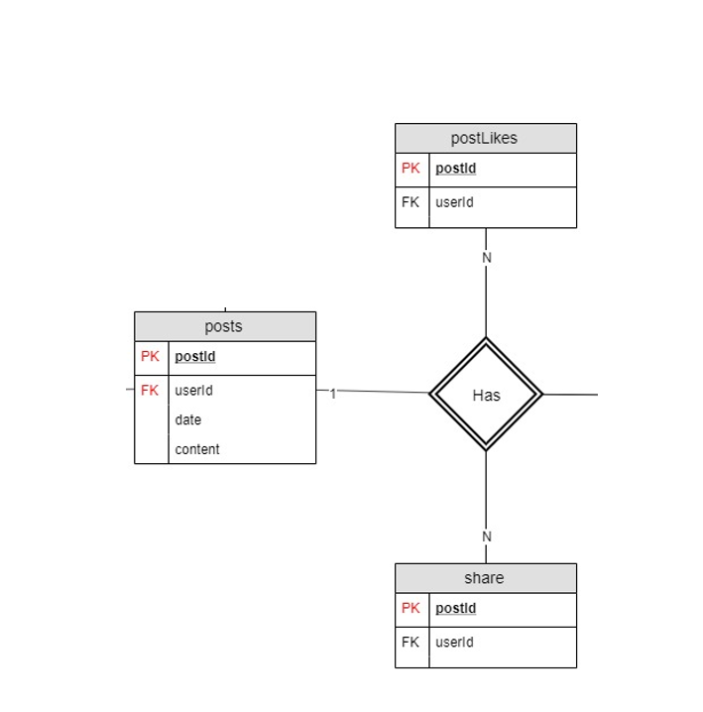

Slide 14
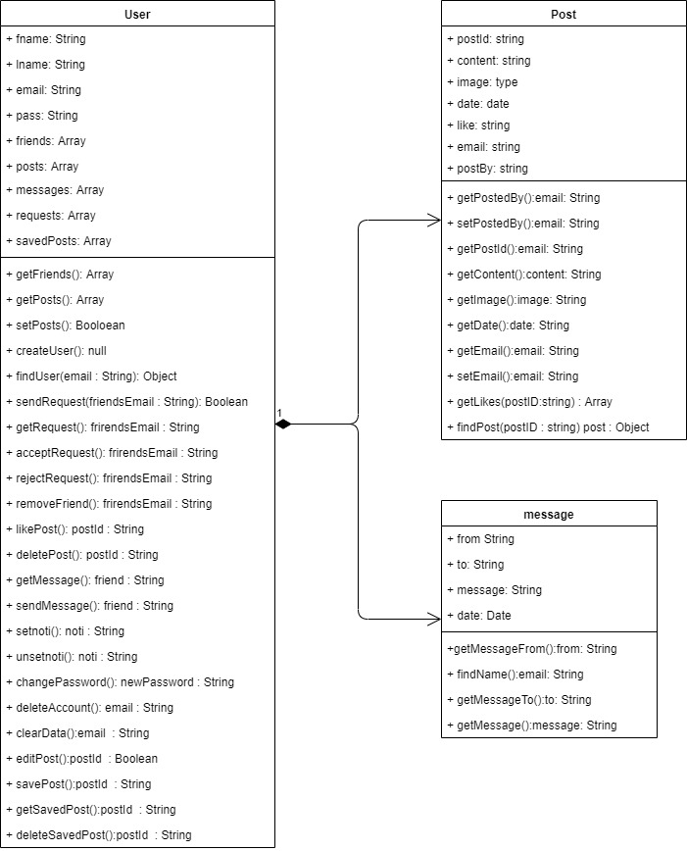
Class Diagram

Slide 15
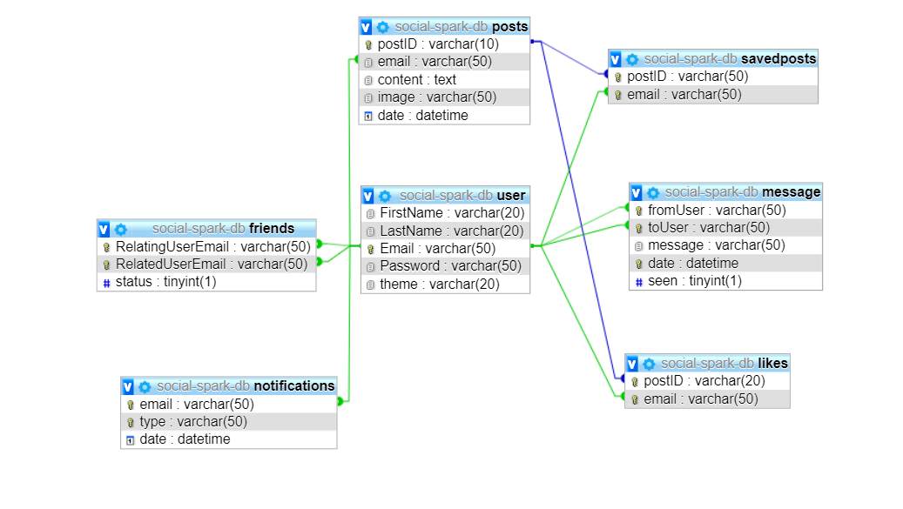
Database Design

Slide 16
User Interfaces

Slide 17
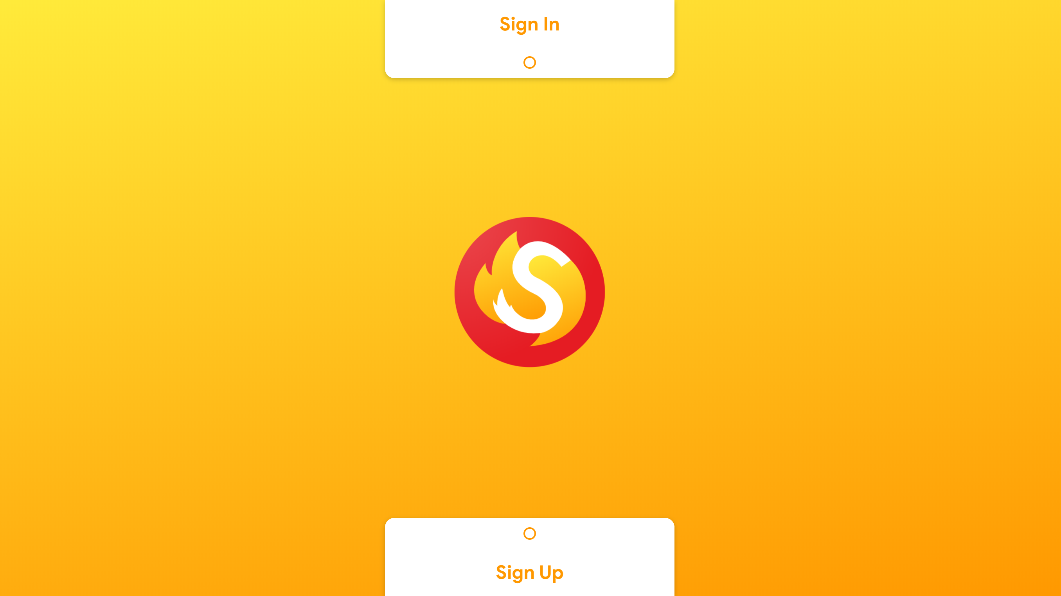

Slide 18
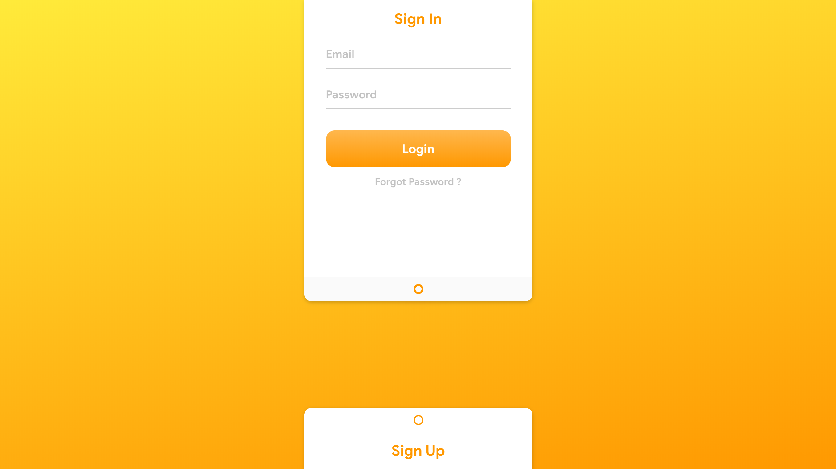
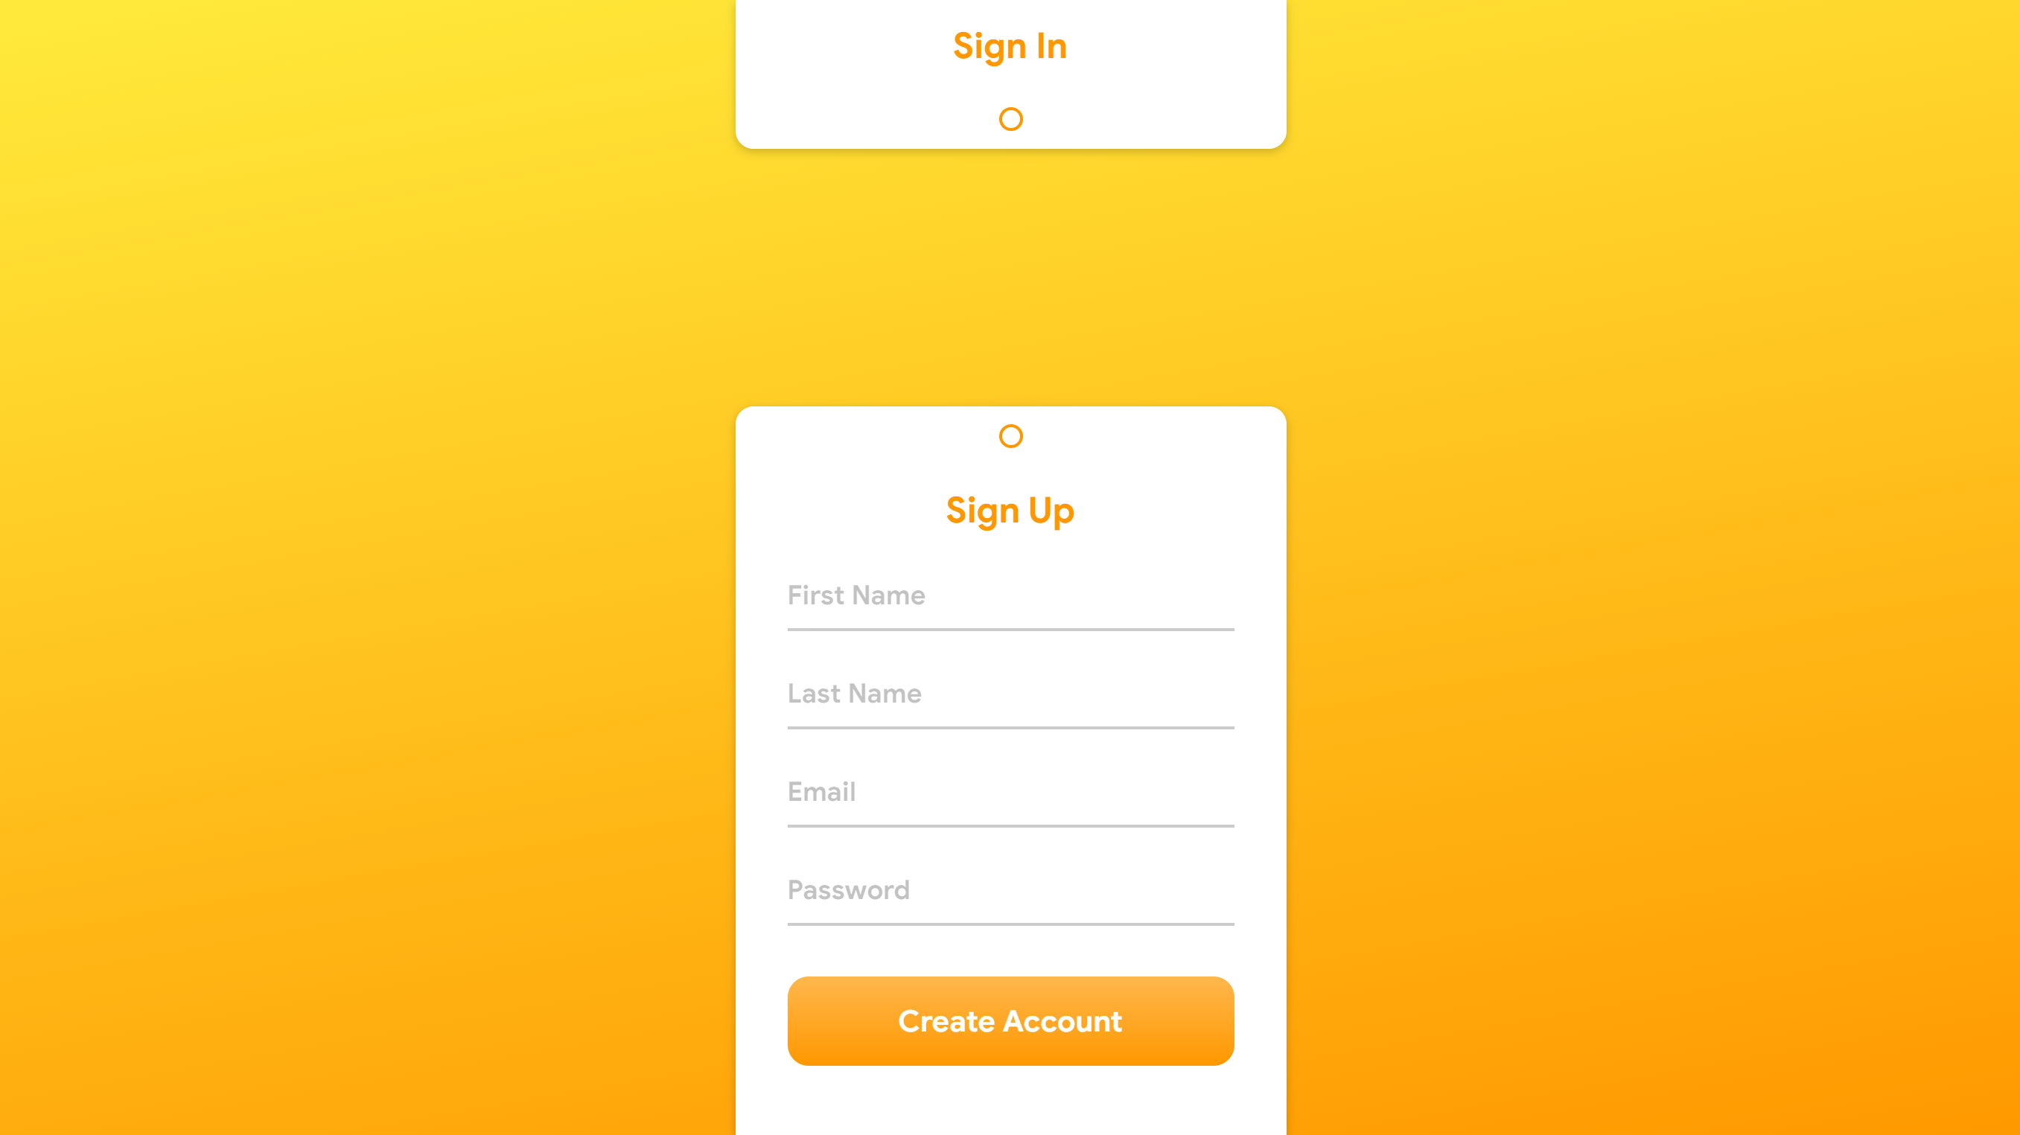

Slide 19
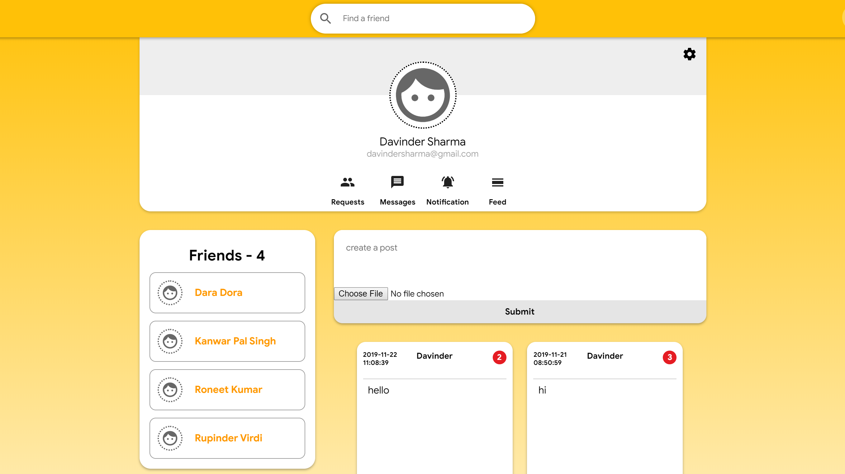

Slide 20
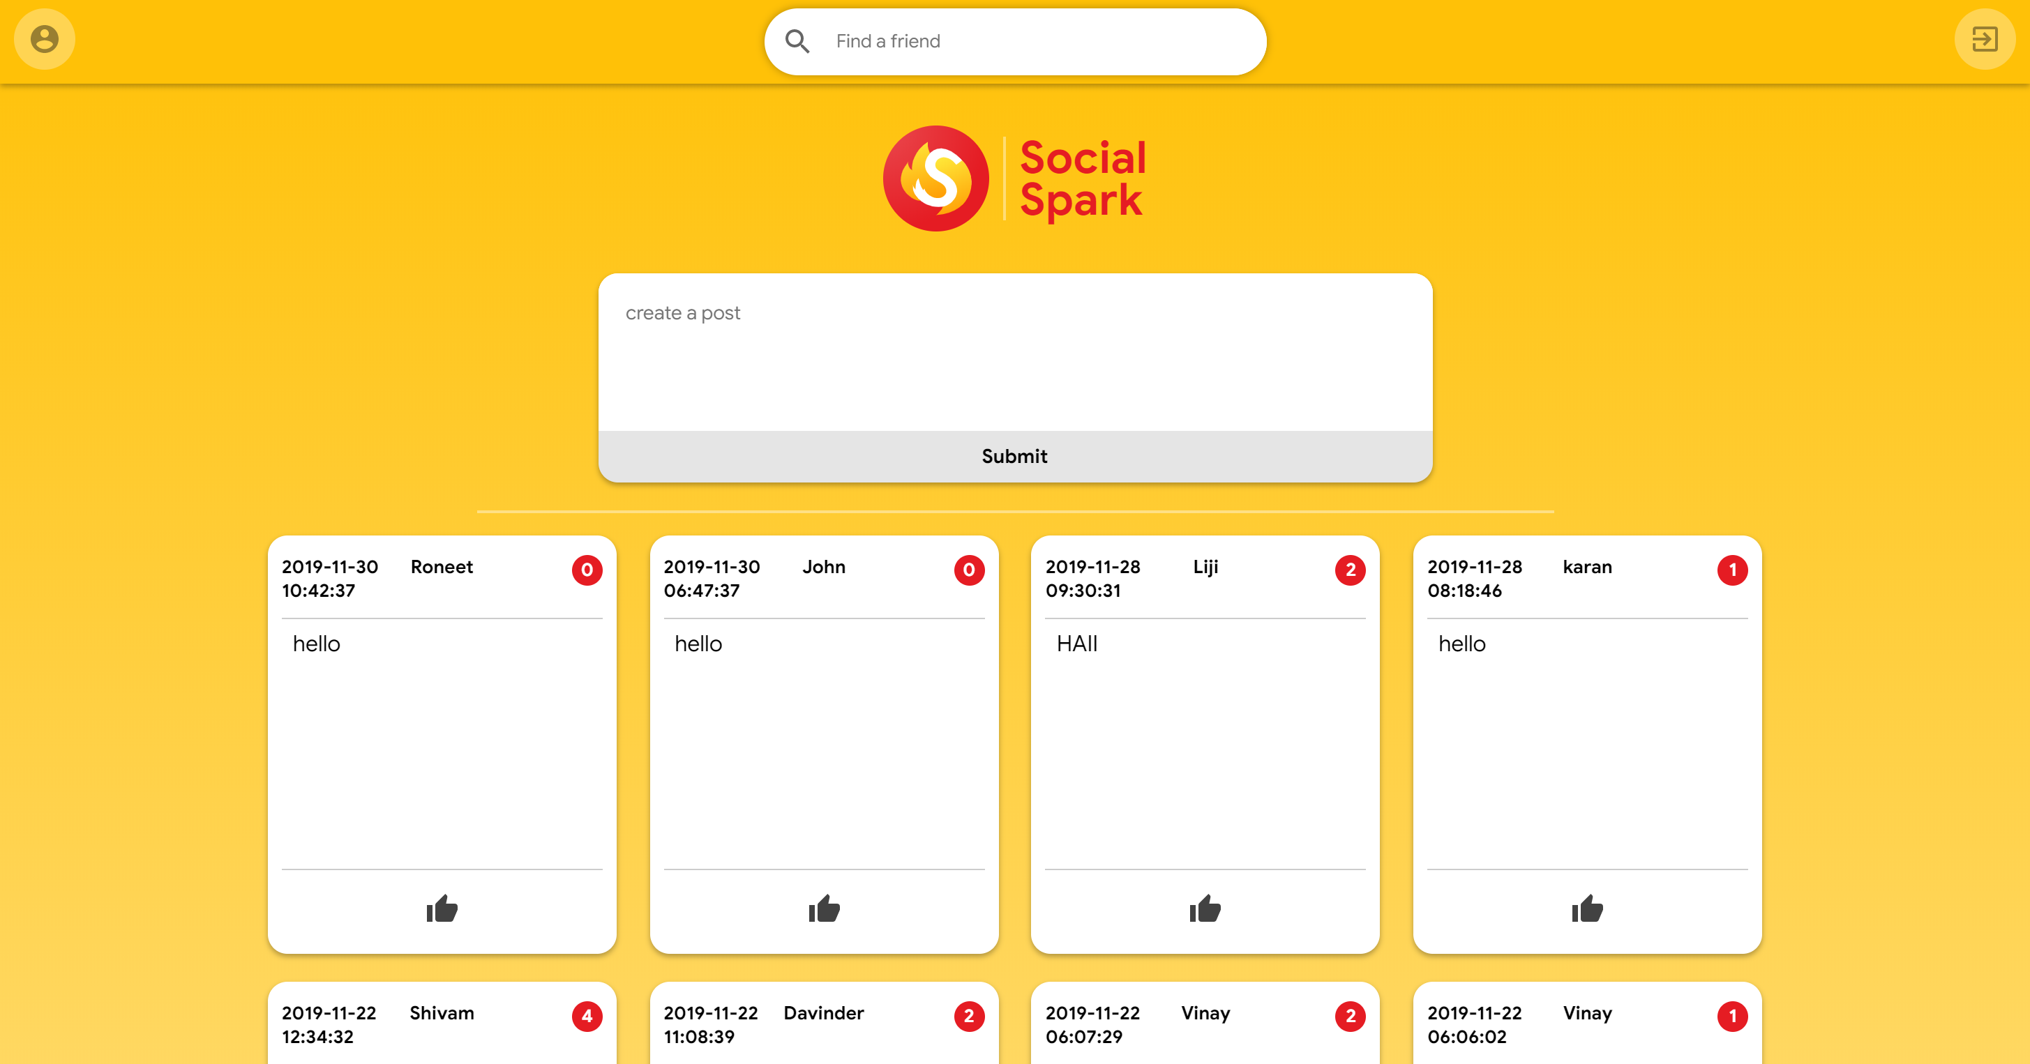

Slide 21
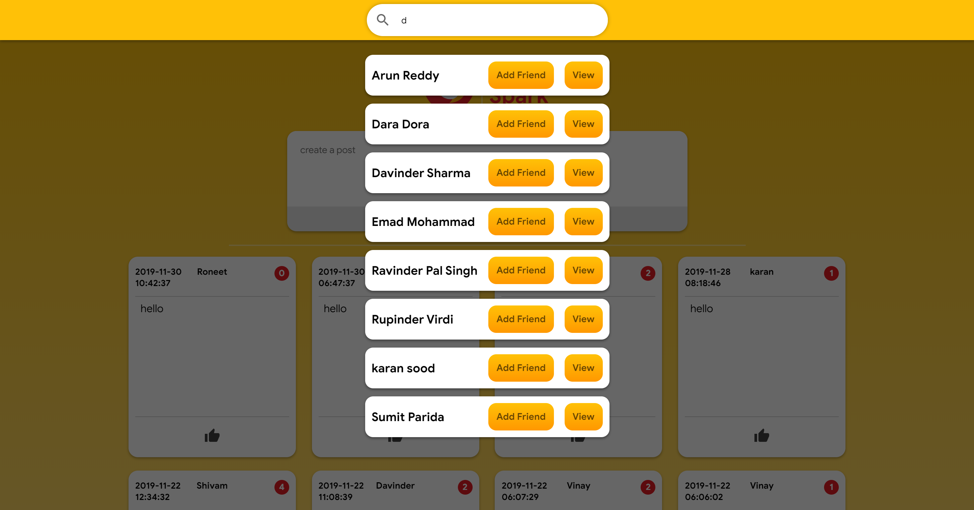

Slide 22
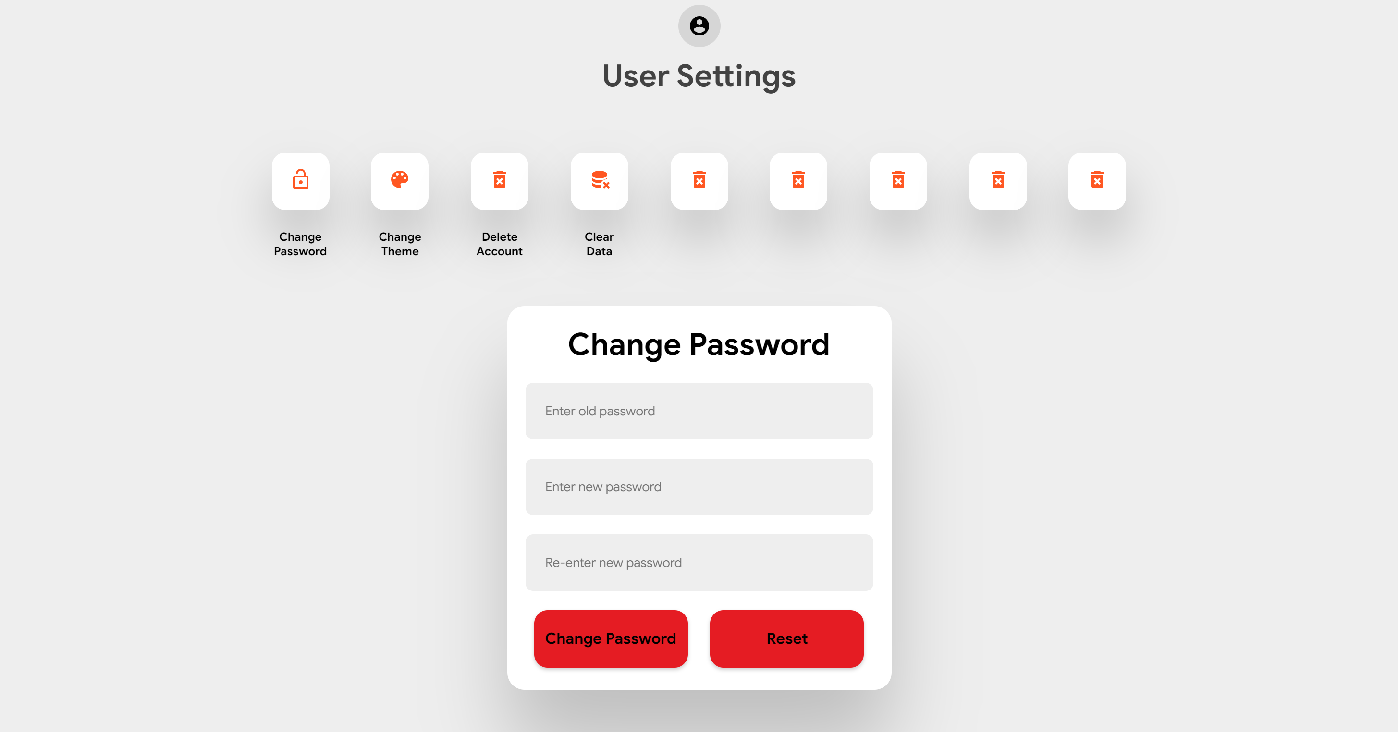

Slide 23
"SELECT * from user WHERE Email IN(SELECT RelatedUserEmail FROM friends WHERE RelatingUserEmail=? AND status =?)
User and Friend Relationship

Slide 24
Road Map
Group Messages
Post Privacy
Report
Malicious Accounts
User Groups

Slide 25

<Source Code/>
https://github.com/roneetkumar/social-spark

Slide 26
Thank You
Presented by: Liji Anna Jiji and Roneet

